Slide 1
DysLearn simplifying Notes, Empowering MInds
Inclusive Learning for Dyslexic Students in Bharat
Team : CODECARE
Ayush Kumar ( IIEST Shibpur )
Shyam Kumar ( Bit Mesra )

Slide 2
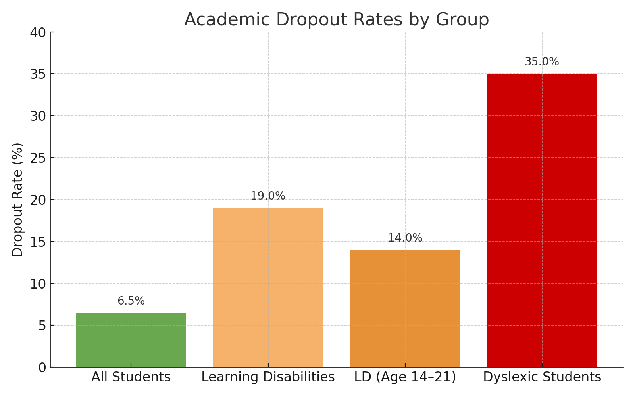
Problem Statement
5–15% of Indian students face dyslexia-related learning barriers
Lack of tailored digital tools in regional contexts
Reading difficulty, low retention, academic anxiety
Educational materials are too dense
“Lack of tools that adapt reading experience to individual dyslexic needs.”

Slide 3
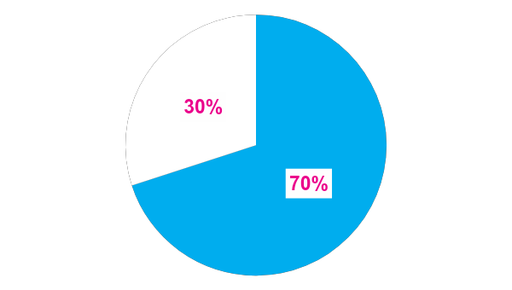
Why it Matters
Real Impact
Student lose self-confidence and motivation
70% report frustration
in learning
Tools gap widens academic inequality
Personalized readability can boost reading effectiveness by 75%.
Ineffective reading support leads to 70% frustration and disengagement
“We don’t need to fix the child, we need to fix the system.”

Slide 4
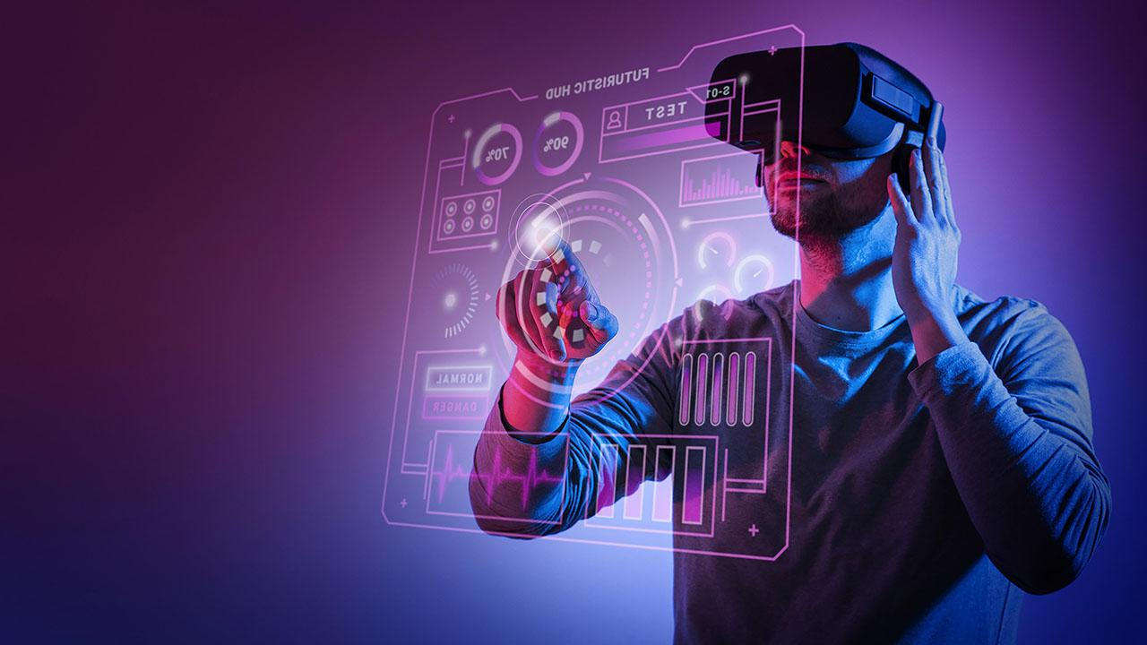
Mission & Solution
Our Mission
Solution Overview
Empathy-Centered Design
Accessibility-First Learning
Personalized Reading Tools (Font, Spacing, Syllable Highlight)
Affordable, Inclusive, Multilingual Tools for Bharat
Text Simplification Engine
Voice-to-Text + Text-to-Speech
Dyslexia-friendly Fonts & Layouts
Special Dyslexic Mode
Pronunciation Checker
Offline PDF Generation
Input
Processing
Output Pipeline

Slide 5
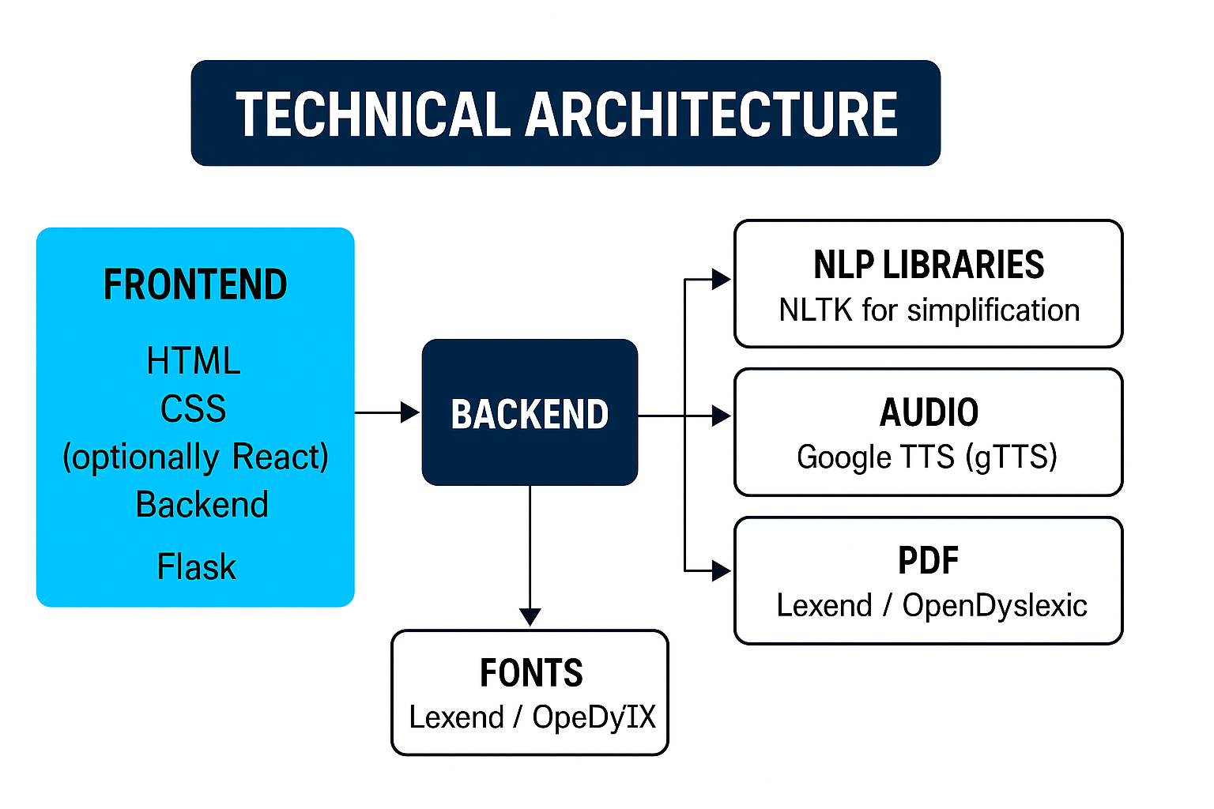
technical Architecture

Slide 6
Why Dyslearn Stands Out
Features | DysLearn | TradiTional Tools
Text Simplifier | Yes | No
Audio Support | Yes | No
Offline Access | Yes | No
Regional Support | In Progress | Rare
Dyslexic mode | Yes | No
Pronunciation help | Yes | No

Slide 7
Future Roadmap
02
04
Multilingual expansion
Lms Integration
Support Hindi, Marathi, Tamil, Bengali Goal: 22 Indian languages
Plug-ins for NEP/DIKSHA platforms Rural remedial learning modules
01
03
Ai-Based Personalization
Mobile app
development
Smart reading level adjustments
Voice feedback with tone adaptation
Pronunciation feedback & reading fluency monitor
Offline Android-first app Voice & gesture-based UI
Accessibility toggle for reading mask, font & syllables

Slide 8

Feature DEMO
Demo video link
Before: dense, uniform text
After: simplified + Dyslexic Mode with highlights and spacing
Github link- shyam242/Dyslearn

Slide 9
Scaling Plan
1. Partner With :
2. OutREach via BharatNet
School Boards
3. Open-source support
EduTech Bodies
Dyslexia NGOs

Slide 10
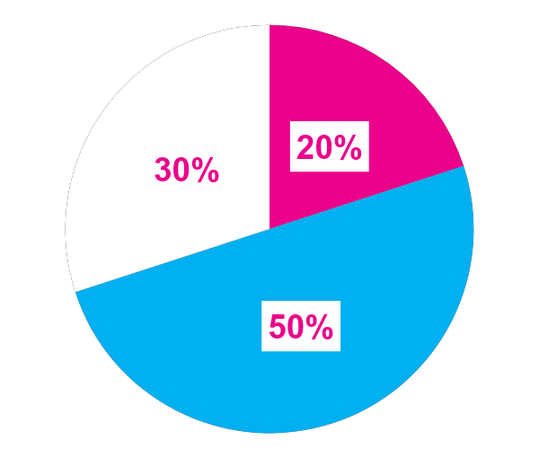
Impact & Reach
Target Groups
Students (Primary)
Parents (Supporters)
Teachers (Enablers)
Estimated Reach: 2.5M+ in India
“With adaptive reading support, potential reading effectiveness improvement: +75%.”

Slide 11

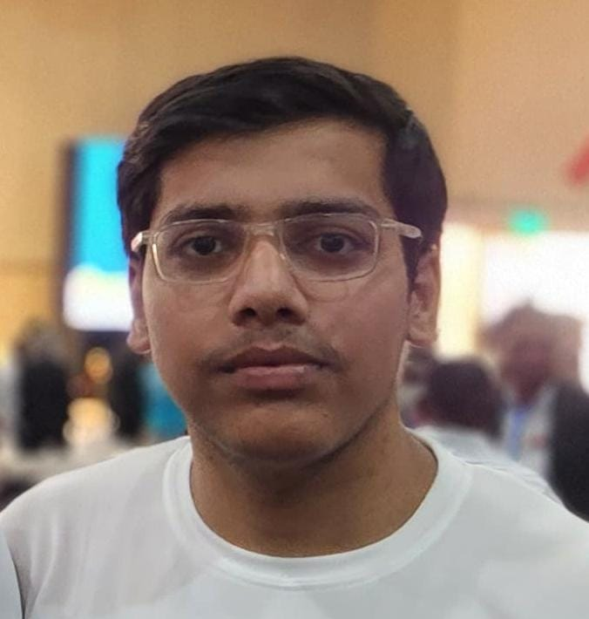




Our team
Ayush Kumar
Shyam Kumar
Pre-Final Year, Btech in Computer Science and Technology, from
IIEST Shibpur
Pre-Final Year, Btech in Electronics and Electrical Engineering, from
BIT Mesra

Slide 12
Thanks!
"Together, let's make learning accessible, inclusive, and empowering for all."

